Slide 1
KARAMOJA REGION
Research presentation
by:Dennis Mwamu
Data analyst
01

Slide 2


RESEARCH UNDERSTANDING
Karamoja is a food insecure region in Uganda.
Factors like pests and diseases and also drought cause low productivity levels
-Several NGO’S provide technical support even farm inputs to the farmers.
-Dalberg Data Insights needs to develop a new food security monitory tool to support the decisison making of NGO’S in Karamoja
RESEARCH QUESTIONS
1)What is the crop area in each District in the Karamoja region?
2)What is the comparison between maize and sorghum production the particular region?
3)What is the district production capacity?
4)What is the production capacity in the subcounty region ?

Slide 3
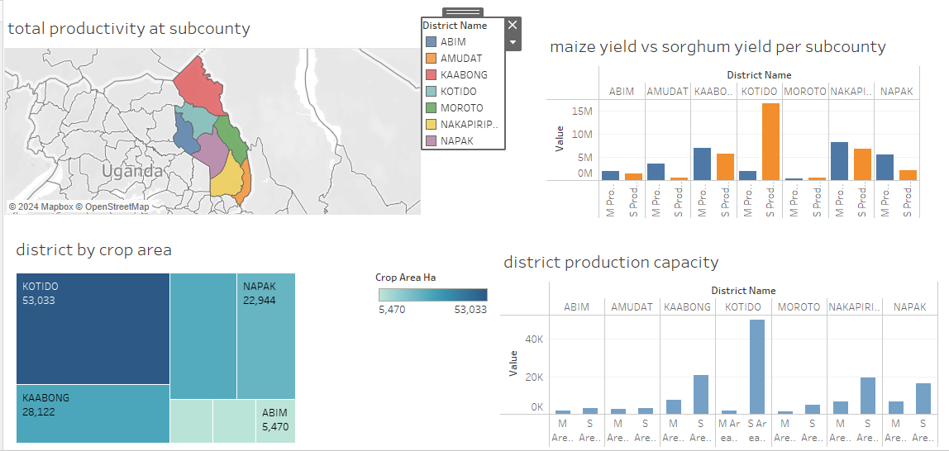
www.reallygreatsite.com

Slide 4
THE FINDINGS
1)Kotido had the highest crop production per district
2)Moroto and Abim had the least crop productions.
3)Maize is the best doing crop in the region as it does well in Nakapiripirit and sorghum does well in Kotido district.
4)Kaabong has the highest population but its crop productivity is not what is expected as it has large lands
4)Kotido is the highest crop production subcounty while Southern Division is the worst crop production subcounty
THE RECOMMENDATIONS
-More research to be done in the particular districts that are not producing much crops.
-Farm inputs to be invested in Kaabong which is not doing well yet it has a large population.
-The NGO’S to facilitate better and effective pesticides to the region.
-The NGO’S can put more efforts to Morot and Abim districts as they have the lowest crop production.
-The NGO’S can dig boreholes for the most drie area and also some water resorvoir facilities.
THANK YOU

